Slide 1


Slide 2


Orientation

Slide 3
General Instructions
During Session
Attendance will not be given if you come after 5 minutes.
Every session quiz will be conducted in the first 5 minutes based on the portions covered in the previous class.
Using gadgets inside the classroom is not encouraged.

Slide 4
Attendance Policy
Maintain 75 percentage of attendance.
Attendance will be projected with absentees list. Do pay attention, no modifications will be encouraged.
In case of any issues with respect to attendance reach the faculty attendance will be modified only if your faculty acknowledges the same.

Slide 5
Attendance Policy
Attendance gets blocked on every Monday. No changes will be made after that even for the valid reason.
During exams, attendance will be get blocked on last working day.

Slide 6

Assessments
NOTE: Assessments will be conducted offline in respective class rooms
CAT and FAT exams will be conducted in Labs.

Slide 7
Tentative Evaluation Policy and Grading Criteria
Assessment Tests |  |  | Weightage(70%)
Type of Exam | Total Marks | Weightage | Duration | Number of Question
CAT 1 / CAT 2 | 30 | 15% | 50 mins for Aptitude courses and 75 mins for Technical courses | 40 MCQs- Aptitude 10 MCQs & 2 Coding - Technical
FAT | 50 | 40% | 60 mins for Aptitude courses and 90 mins for Technical courses | 50 MCQs- Aptitude 20 MCQs & 2 Coding - Technical
Internal assessment |  |  | Weightage(30%)
Type of Assessment | Total Marks | Weightage | Remarks
Assessment 1 | 15 | 15% | 2nd & 3rd September 2024(As per your slot)
Assessment 2 | 15 | 15% | 9th & 10th October 2024(As per your slot)

Slide 8

Reference Materials
Materials will be provided on course page(VTOP Portal)
Each topic will be provided with quiz link and practice questions.

Slide 9
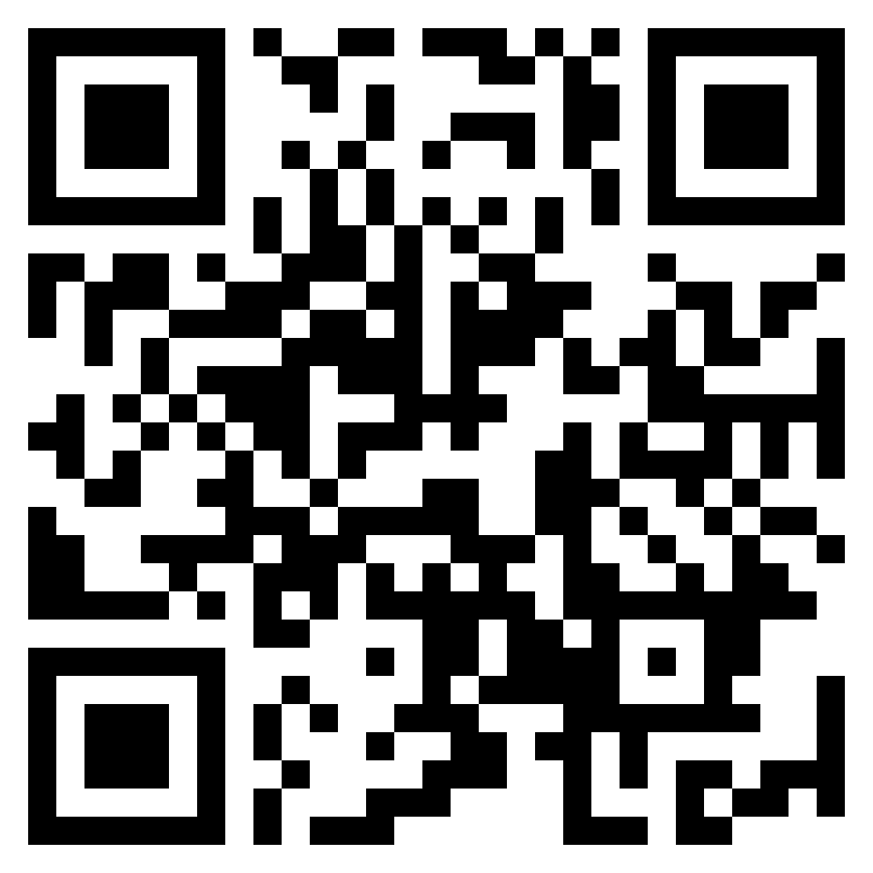
Help Desk
Any concerns related to attendance/marks/faculty, you can reach out to ETHNUS helpdesk through the displayed QR code
https://codemithra.com/vit-helpdesk/

Slide 10








/ethnuscodemithra
Ethnus Codemithra
/ethnus
/code_mithra
THANK YOU
https://learn.codemithra.com/
codemithra@ethnus.com
+91 7815 095 095
+91 9019 921 340

